Slide 1
The joystick: obviously everyone’s favorite component
By Clarissa and Nathan

Slide 2
What does it do?
The joystick has three abilities: It returns two values(x and y) between 0-1024 as well as select values (0 and 1).
Basically you can go up, down, side to side, and push down to select

Slide 3
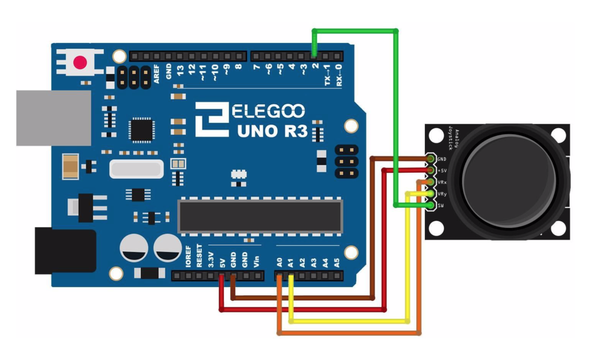
How does it do what it does?
The joystick uses 5 pins: VCC (5v), Ground, X(analog), Y(analog), Switch/Key(digital)
The switch is optional

Slide 4
How do I use it?
Joysticks basically works like potentiometers but with an added dimension and a button feature.
We advise you use your thumb to move it around and get different values. Other fingers are fine, just not as cool.

Slide 5

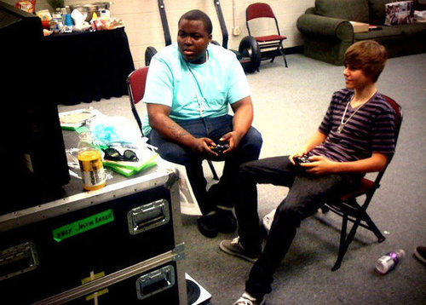


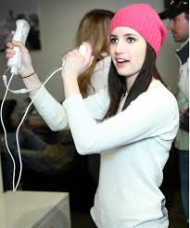

Famous people using joysticks

Slide 6
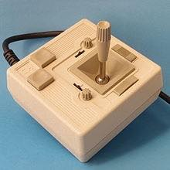
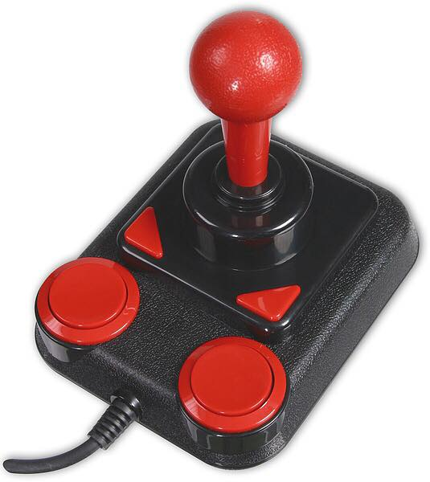
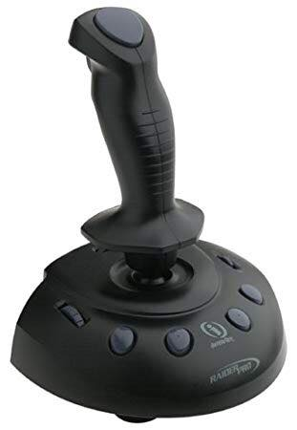
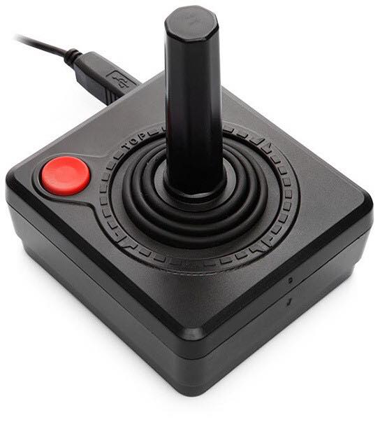

Joystick over the years
*Omitted dildo picture*

